Slide 1

VGP104 - Software Development and Testing
Instructor: Peter Chan

Slide 2
Agenda
Rule #9 - If You Didn't Fix It, It Ain't Fixed
Review

Slide 3
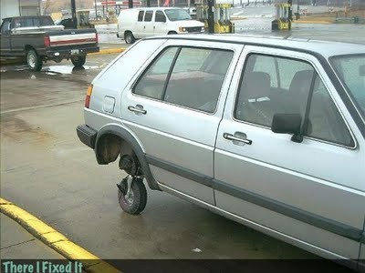
Rule #9 - If You Didn't Fix It, It Ain't Fixed

Slide 4
Rule #9 - If You Didn't Fix It, It Ain't Fixed
Check that the bug is really fixed
If you followed "Make It Fail", you will know how to prove that you've fixed the problem
No matter how obvious the problem and the fix seem to be, you can't be sure until you test it, never assume that the fix works
Example: Havok "optimization"

Slide 5
Rule #9 - If You Didn't Fix It, It Ain't Fixed
Check that it's really your fix that fixed it
When you think you've fixed a problem, take the fix out, make sure it's broken again. Then put the fix back in, make sure it's fixed again
How can this be? Sometimes, it might be your test data or test sequence that hide the bug, and your fix didn't actually address the problem

Slide 6
Rule #9 - If You Didn't Fix It, It Ain't Fixed
The important thing to keep in mind, it never just "go away" by itself
"Maybe it won't happen again." Guess what? It will.
Sometimes you run out of time, or it's a hard to reproduce problem, at the very least you should add some instrumentation
Example: Infinite loop in navigation system

Slide 7
Rule #9 - If You Didn't Fix It, It Ain't Fixed
Fix the cause, not a patch that hides the problem
Fix the process, so it won't happen again
Example: Agent reference and the copy constructor

Slide 8
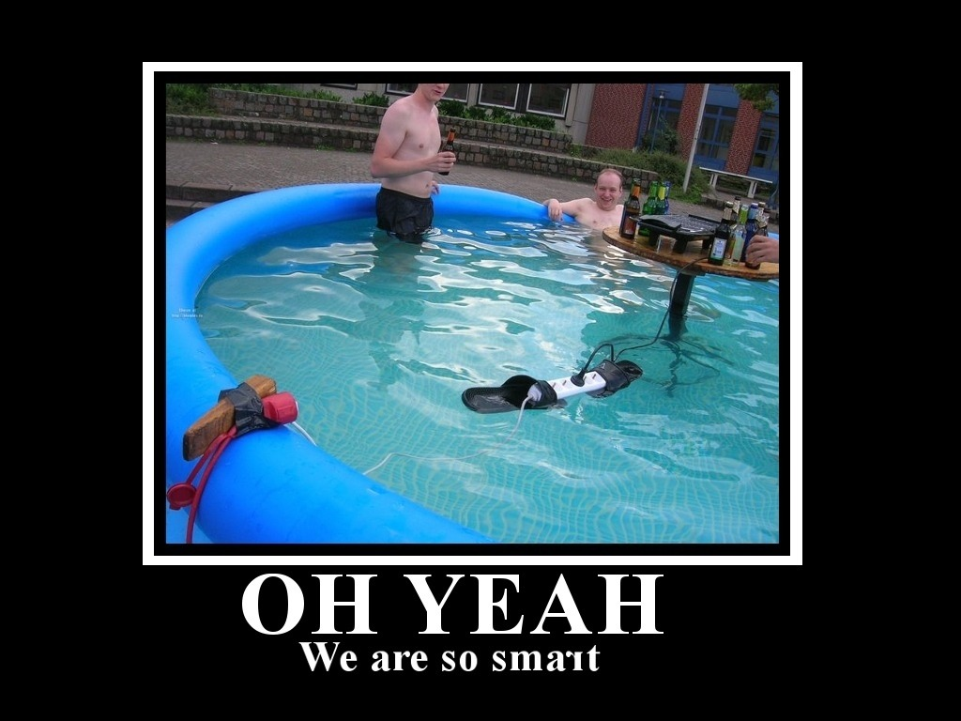
Review

Slide 9
Software Development Cycle
Requirement Analysis
Design
Implementation
Testing

Slide 10
C++ Build Process
Source Code
Preprocessor
Compiler
Linker
Loader

Slide 11
Types of Errors
Syntax Errors
Linker Errors
Runtime Errors

Slide 12
Debugger
Local, Auto, Watch Windows
Callstack
Output Window
Memory Viewer
Disassembly

Slide 13
Memory Layout
Registers, Cache, RAM, Hard drive
Text Segment, Globals, Stack, Heap
Stack Frames

Slide 14
Pointers and Arrays
Guideline for using pointers
Relationship between pointers and arrays
Shallow copy vs Deep copy
Dynamic Allocations
Memory Leaks and Memory Stomps

Slide 15
Testing
Verification vs Validation
Drivers and Stubs
Preconditions and Postconditions
Static vs Dynamic Testing
White Box Testing vs Black Box Testing
Test Cases

Slide 16
Types of Testing
Unit Testing
Integration Testing
System Testing
Regression Testing
Acceptance Testing
Smoke Testing

Slide 17
Agile Software Development
Motivation and Value
Agile Manifesto
Test Driven Development
Scrum

Slide 18

The 9 Rules of Debugging

Slide 19
The 9 Rules of Debugging
Understand the System
Make it Fail
Quit Thinking and Look
Divide and Conquer
Change One Thing at a Time

Slide 20
The 9 Rules of Debugging
Keep an Audit Trail
Check the Plug
Get a Fresh View
If You Didn't Fix it, It Ain't Fixed

